Slide 1
Love at First Sight with PowerApps and Flow
Notes:
This module introduces the core concepts of creating and executing queries in Power BI Desktop. Students will learn how to leverage the query features of Power BI Desktop to import data from a variety of sources including databases, Excel spreadsheets, web pages and SharePoint lists. Students will also discover how to design queries to clean up, transform and reshape data during the import process by learning about all the different type of query operations available in the Power BI Desktop query builder. The module also examines the use of query parameters and powerful transform operations such as merging columns and appending rows from multiple data sources. The module concludes by explaining to students how to design queries to convert an OLTP database design into an OLAP data model that is better suited for data analysis and reporting in a Power BI Desktop project.

Slide 2
Agenda
Building Apps with PowerApps Studio
Understanding Connectors and Connections
Building PowerApps for SharePoint Online
Extending PowerApps using Microsoft Flow
Advanced Topics with PowerApps & Flow

Slide 3
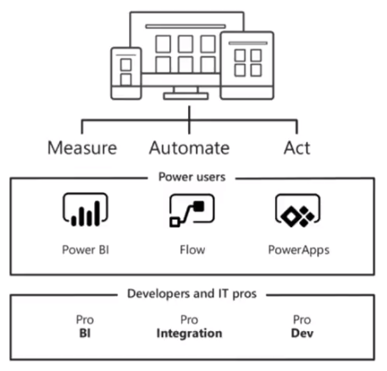
Business Application Platform
Power BI
PowerApps
Flow

Slide 4
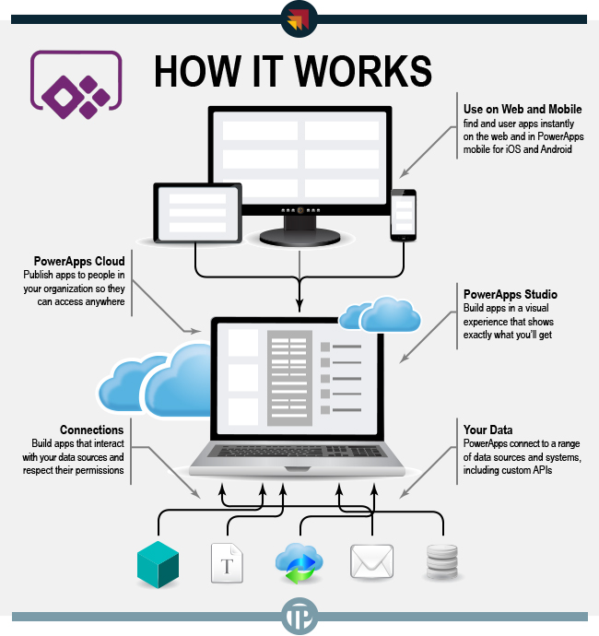
What is PowerApps?
Service for building and using custom business apps
Apps run in any browser and on mobile devices and tablets
Apps connect to datasources and services through connectors
Targeted at Power Users more than professional developers

Slide 5
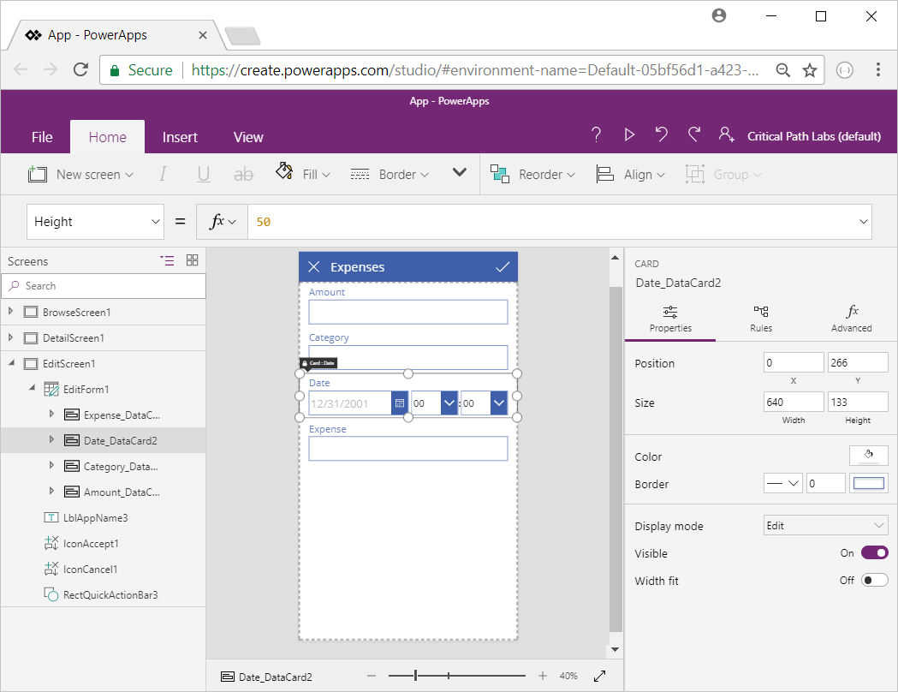
PowerApps Studio Interface
Notes:
Left navigation bar: display a thumbnail for each screen in your app or a hierarchical view of all the controls on each screen.
Middle pane: shows the screen that you're working on and canvas area.
Right-hand pane: where you set properties, data sources, and advanced options.
Property drop-down list: where you select the properties that formulas apply to.
Formula bar: where you add formulas (as in Excel) that define app behaviour.
Ribbon: where you add controls and customize design elements.
Ribbon tabs: each ribbon contains a set of contextual-tabs. The New Screen button is on both the Home and Insert ribbons.

Slide 6
Screens and Controls
Screens represent the atomic of UI design
Your app can have as many screens as you need
Your app supplies means to navigate across screen
You can add controls to screens
Controls properties change appearance and behavior
Control properties can be input or output properties
Control properties not used for 2-way binding
Properties configured in Properties tab or in formula bar

Slide 7
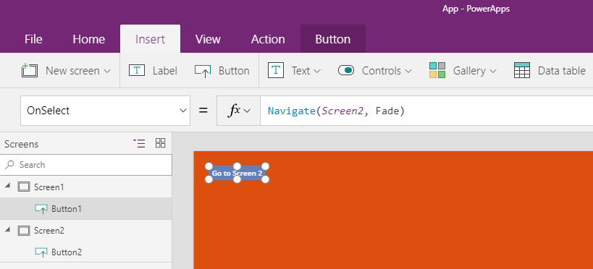
Interactivity & Screen Navigation
Create buttons to drive navigation

Slide 8
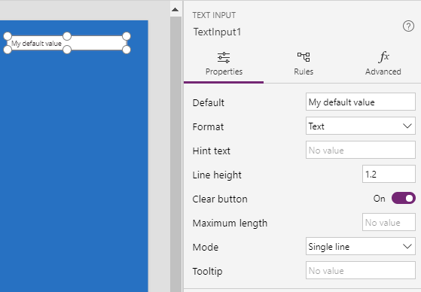
Properties Panel
Used to configure control properties without writing a formula
Properties exposed varies based on control

Slide 9
Adding Controls
Text:
Label, Text input, HTML Text, Pen input
Controls:
Button, Dropdown, Date picker, List box, Checkbox, Radio, Toggle, Slider, Timer
Gallery:
Vertical, Horizontal, Flexible height, Blank vertical, Blank horizontal
Data table
Forms:
Edit, Display, Entity form
Media:
Image, Camera, Barcode, Video, Audio, Microphone, Add picture
Charts:
Column chart, Line chart, Pie chart
Icons

Slide 10
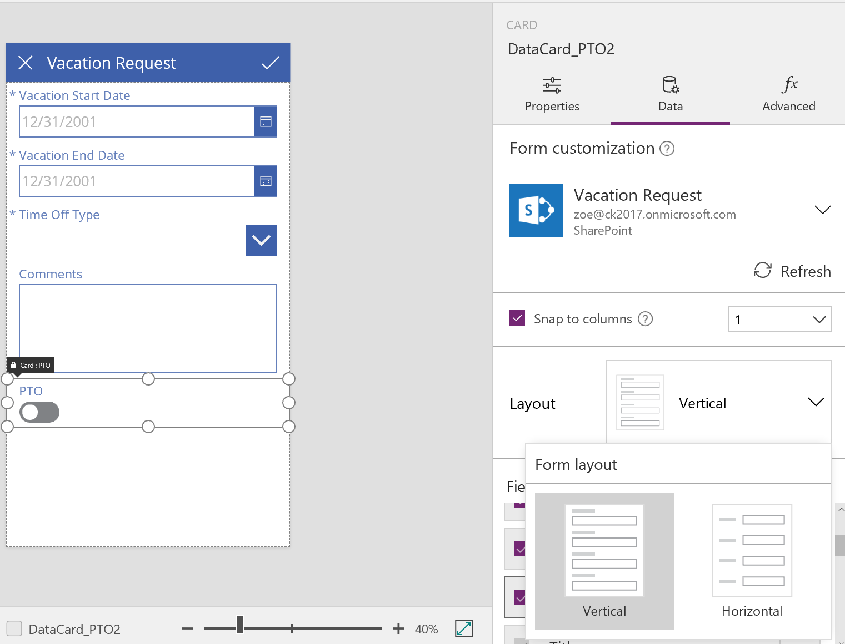
Form Layouts

Slide 11
Card Controls and Data Cards
Card controls
Building blocks of the Edit and Display form controls
Form represents entire record
Card represents a single field of the record
Cards configured in right-hand pane
Choose which fields to show
Change order of fields
Change how to show each field

Slide 12
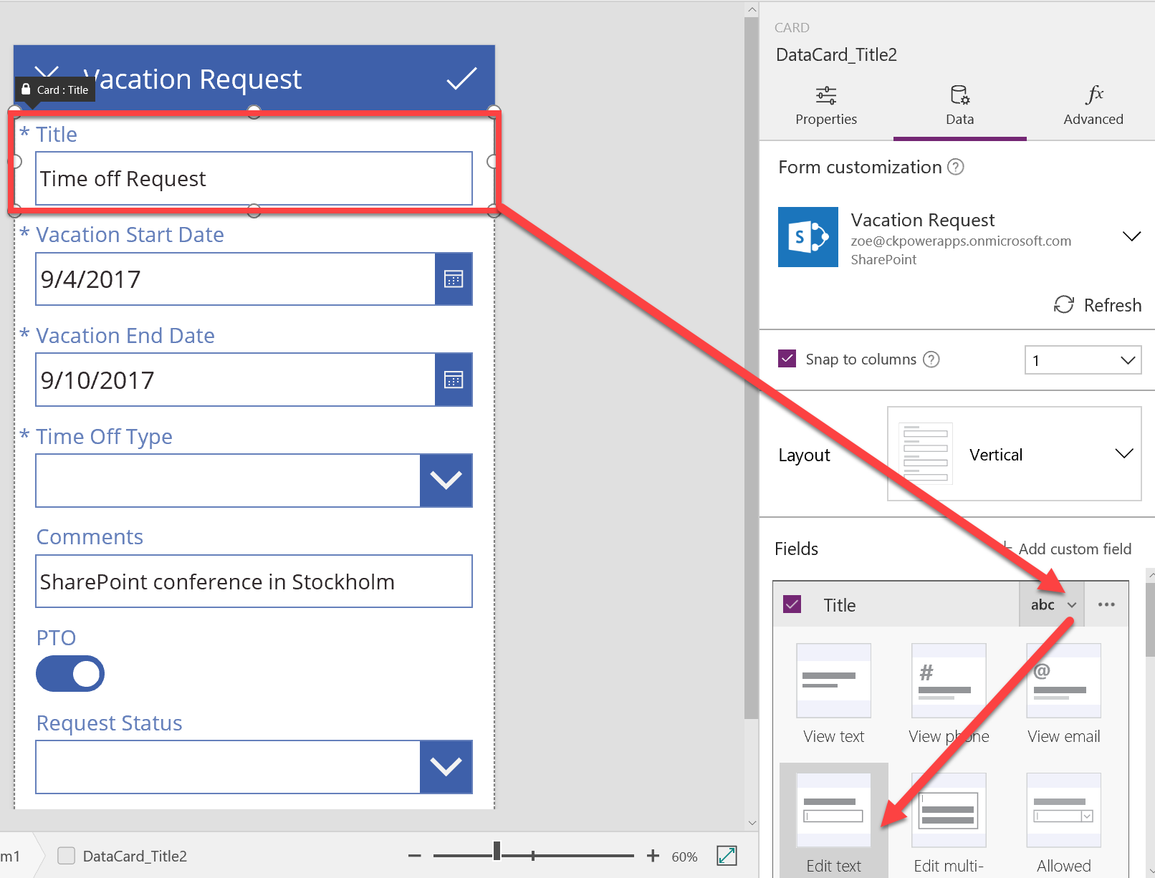
Data Cards

Slide 13
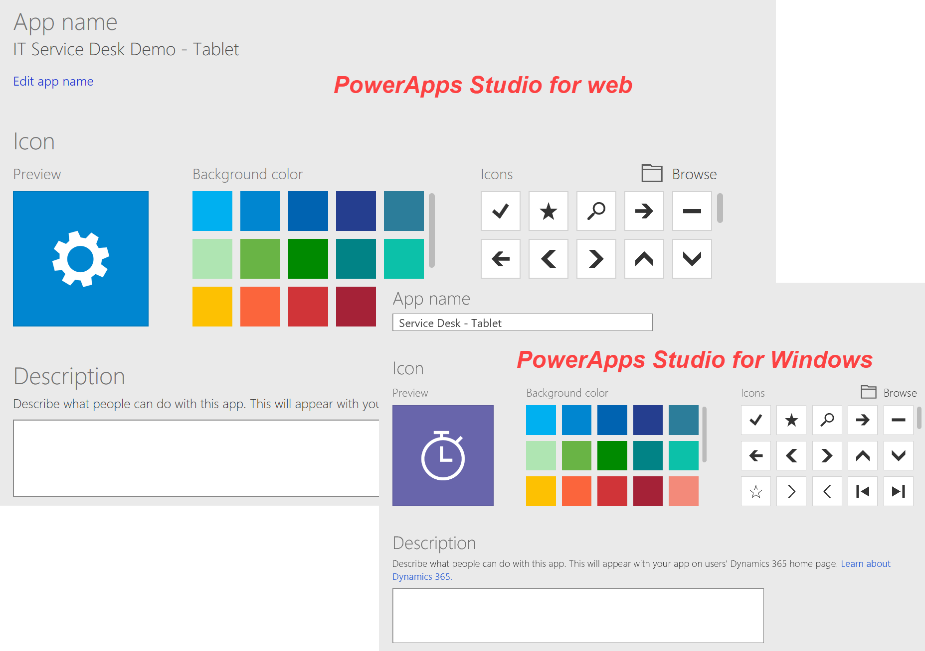
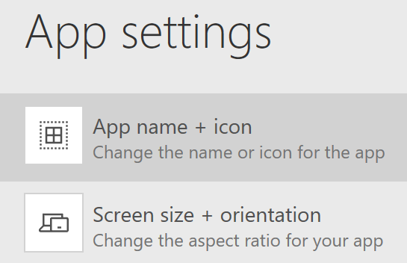
App Name & Icon
Name, icon, and description settings your app
File tab > App Settings (PowerApps Studio)

Slide 14
Agenda
Building Apps with PowerApps Studio
Understanding Connectors and Connections
Building PowerApps for SharePoint Online
Extending PowerApps using Microsoft Flow
Advanced Topics with PowerApps & Flow

Slide 15
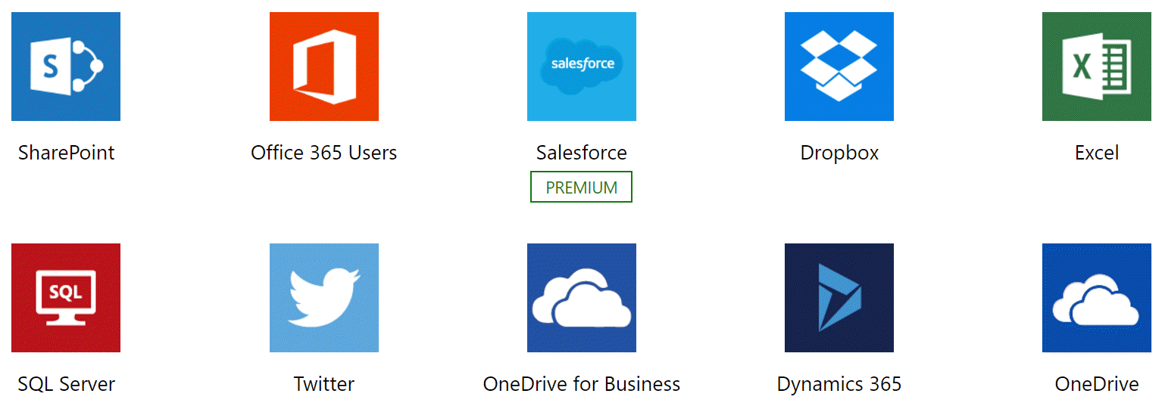
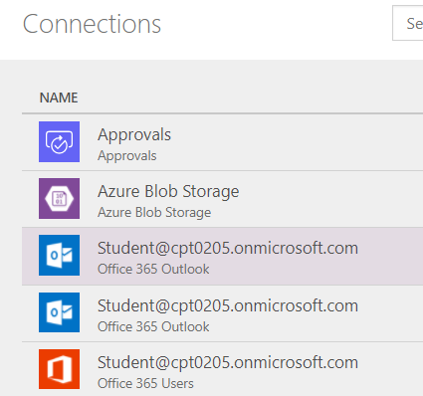
Connectors and Connections
Connector
A wrapper around an API which allows PowerApps and Flow to read and write from external datasource
Connection
Configuration created in order to use a connector
Connection defined data source location, login credentials and granted permissions

Slide 16
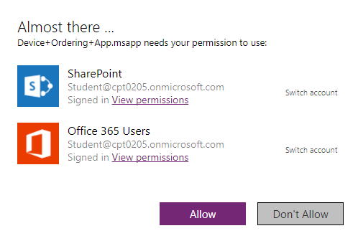
Granting Permissions

Slide 17
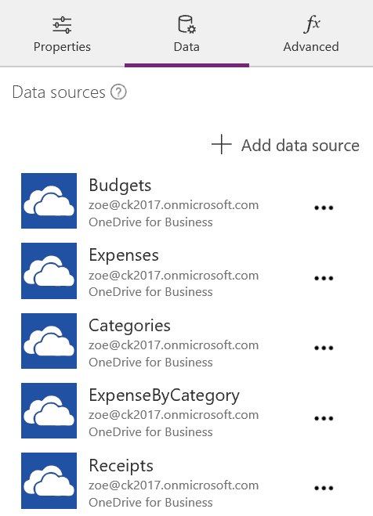
Data Panel
Will list existing data sources
Also provides ability to add new data sources

Slide 18
Understanding Delegation
Delegation is where you can delegate the processing of data to a data source before the data is pulled in an app
Key to building efficient apps
Minimizes the amount of data that needs to be brought into the app
PowerApps includes a powerful set of functions to filter, sort, and shape tables of data
Equivalent to writing database queries

Slide 19
Types of Delegate Functions
Filter functions
Filter, Search, and LookUp can be delegated
Sorting functions
Sort and SortByColumns can be delegated
Aggregate functions
Sum, Average, Min, and Max can be delegated
Not all data sources support this delegation
https://powerapps.microsoft.com/en-us/tutorials/delegation-list/

Slide 20
Agenda
Building Apps with PowerApps Studio
Understanding Connectors and Connections
Building PowerApps for SharePoint Online
Extending PowerApps using Microsoft Flow
Advanced Topics with PowerApps & Flow

Slide 21
SharePoint List
Generate an app automatically based on data in a SharePoint list
Users can manage items in app for SharePoint list
Libraries are NOT supported
By default, the app will have 3 screens:
BrowseScreen1 - browse through all records in the list
DetailsScreen1 - view all fields for a specific record
EditScreen1 - create or edit a record
Customize these screens based on your needs
Not all columns are supported

Slide 22
Agenda
Building Apps with PowerApps Studio
Understanding Connectors and Connections
Building PowerApps for SharePoint Online
Extending PowerApps using Microsoft Flow
Advanced Topics with PowerApps & Flow

Slide 23
What is Flow?
Service for automating workflows across other services
Designed by Microsoft for business users more than developers
What can you do with Flow?
Get notifications
Copy files
Collect data
Automate approvals

Slide 24
Building Blocks of Flow
Flows whether created from a template or from scratch:
Will contain building blocks that work together in certain ways (much like a flowchart)
Building blocks of Flow:
Services - sources and destinations of data in a flow
Triggers - events that start a flow
Actions - tasks accomplished by the flow
Conditions - allow for branching if/then logic in a flow
Loops - for iterating over actions more than once

Slide 25
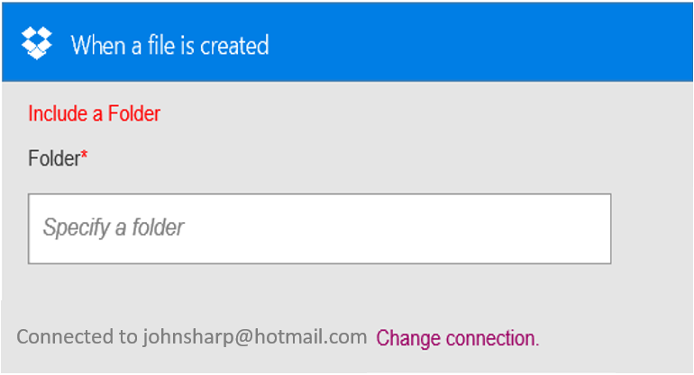
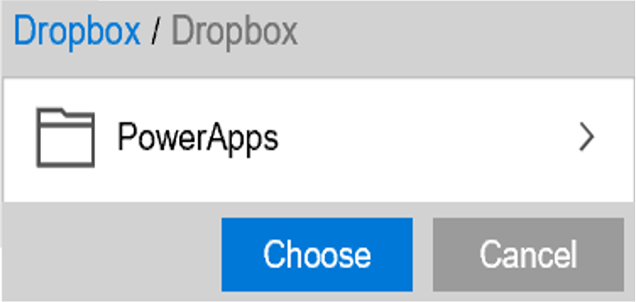
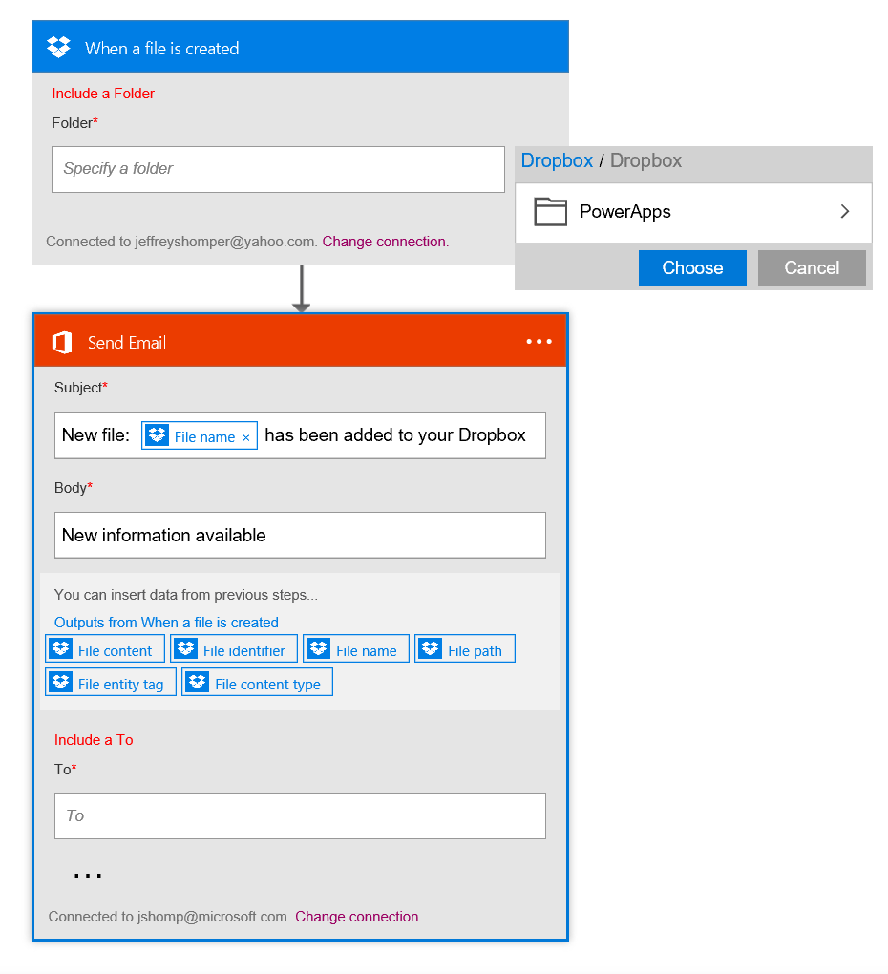
Flow Visual Designer
Sending an Exchange email when a new file is added in Dropbox
Authenticate to your Dropbox account.
Select folder to monitor
PowerApps
Choose to include properties from previous step (Dropbox file) to improve relevance
Authenticate to your O365 account. Build email Subject and Body
Specify Send To email address and additional properties (optional): From, CC, BCC and Importance
Connected to johnsharp@contoso.com

Slide 26
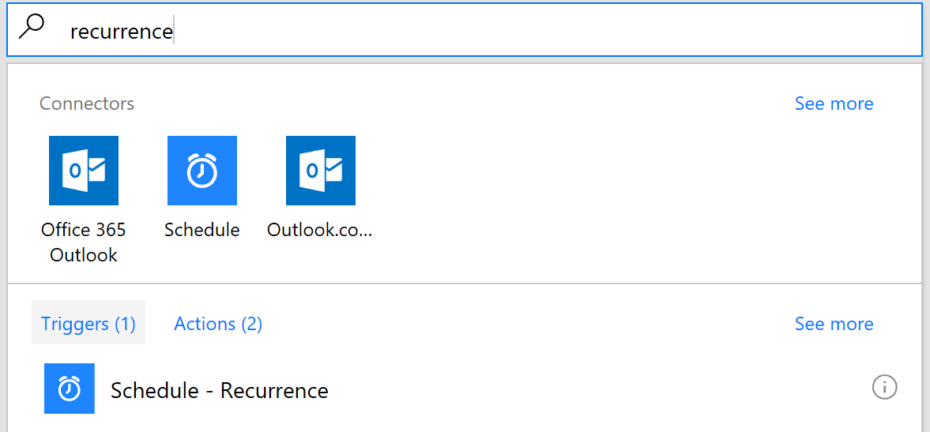
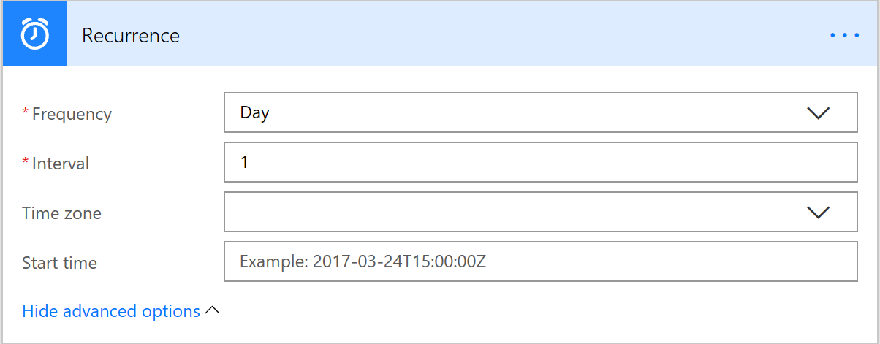
Recurring Flows

Slide 27
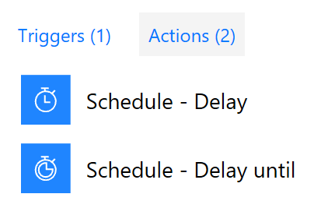
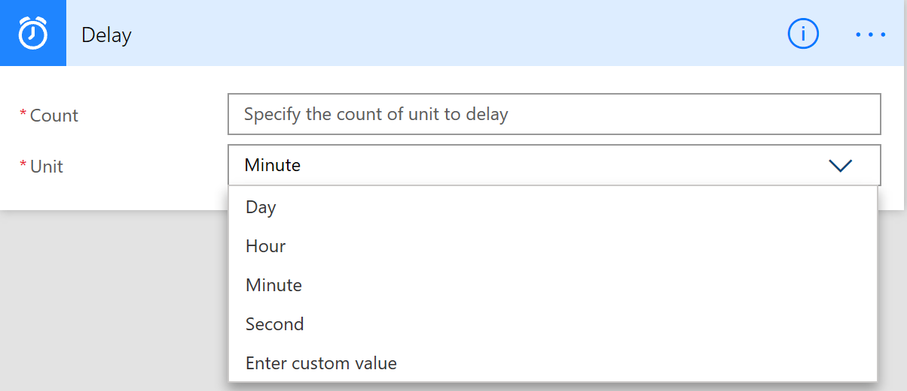
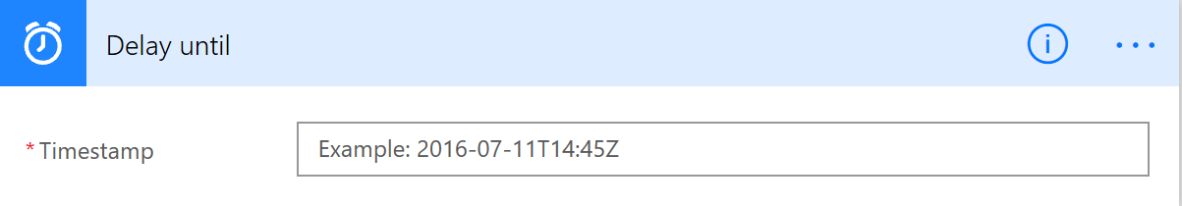
Delayed Flows

Slide 28
Agenda
Building Apps with PowerApps Studio
Understanding Connectors and Connections
Building PowerApps for SharePoint Online
Extending PowerApps using Microsoft Flow
Advanced Topics with PowerApps & Flow

Slide 29
Common Data Service
Common Data Service (CDS) is:
A Microsoft Azure–based business application platform
Enables you to easily build and extend applications with their business data
Includes a Data Model
One of the biggest benefits is:
It does all the heavy lifting of bringing your data together in one place for your users and applications

Slide 30
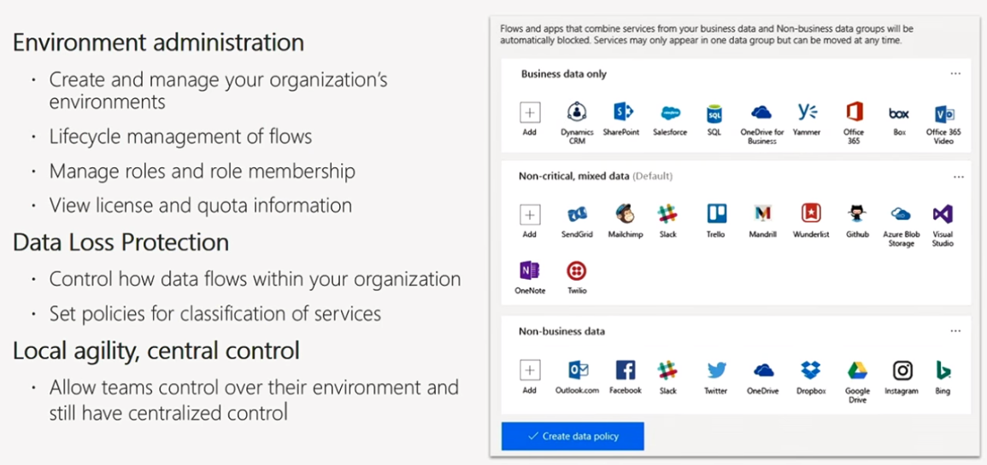
PowerApps and Flow Admin Center

Slide 31
Managing Environments
An Environment is a space to store, manage, and share your organization’s:
Business data, PowerApps, and Flows
Also serve as containers to separate apps that have:
Different roles
Security requirements
Target audiences
How you choose to leverage environments depends on your organization and apps you are trying to build

Slide 32
Environment Roles and Permissions
Environment Admin role - can perform all administrative actions on an environment including the following:
Add or remove a user or group from either Environment Admin or Environment Maker role
Provision Common Data Service database for environment
View and manage all resources created in environment
Set Data Loss Prevention policies
Environment Maker role - can create new resources within environment including apps, connections, custom APIs, gateways, and flows using Microsoft Flow

Slide 33
Data Loss Prevention Policies
Data is critical in an organization’s success
It needs to be readily available for decision-making
Needs to be protected so it’s not shared with audiences that should not have access to the data
Data Loss Prevention (DLP) Policies
PowerApps provides a way to protect your data by providing the ability to create and enforce policies
You can define which consumer services/connectors specific business data may be shared with

Slide 34
Application Lifecycle Management (ALM)
Managing Power Apps
Sharing PowerApps
PowerApp Versioning
Microsoft AppSource
Running PowerApps
PowerApps Mobile
Web Browser
SharePoint List
PowerApps Admin Center and Flow Admin Center
Environments
Data Loss Prevention Policies

Slide 35
Sharing PowerApps
Apps can be shared with:
Users or groups
Entire organization
There are 3 types of sharing options:
Can Use
Users/groups can run the app but cannot share
Can Use and Share
Users/groups can run the app and share with others
Can Edit
Users/groups can run the app, customize it, and share the new version of the app

Slide 36
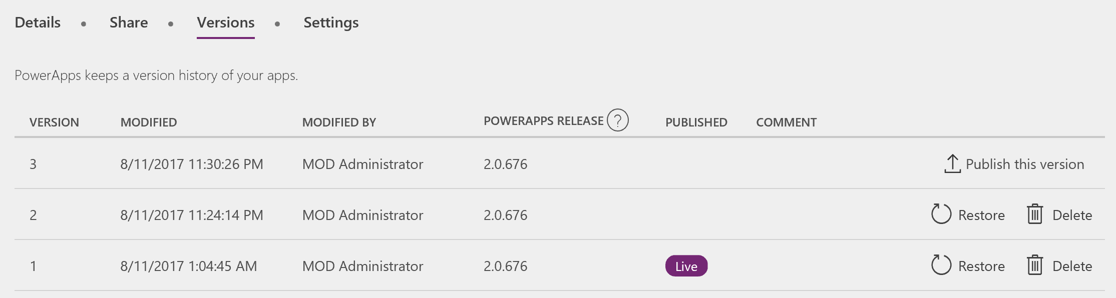
PowerApps Versioning
For apps saved to the cloud, PowerApps keeps a history of changes:
Accessible via https://web.powerapps.com
Restore, delete, and publish versions

Slide 37
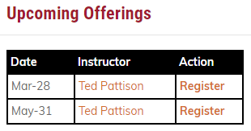
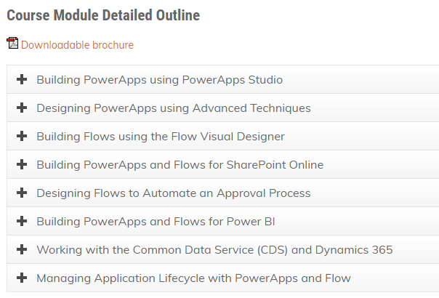
Deep Dive into PowerApps and Flow
See more info at https://www.criticalpathtraining.com

Slide 38
Summary
Building Apps with PowerApps Studio
Understanding Connectors and Connections
Building PowerApps for SharePoint Online
Extending PowerApps using Microsoft Flow
Advanced Topics with PowerApps & Flow

